Slide 1

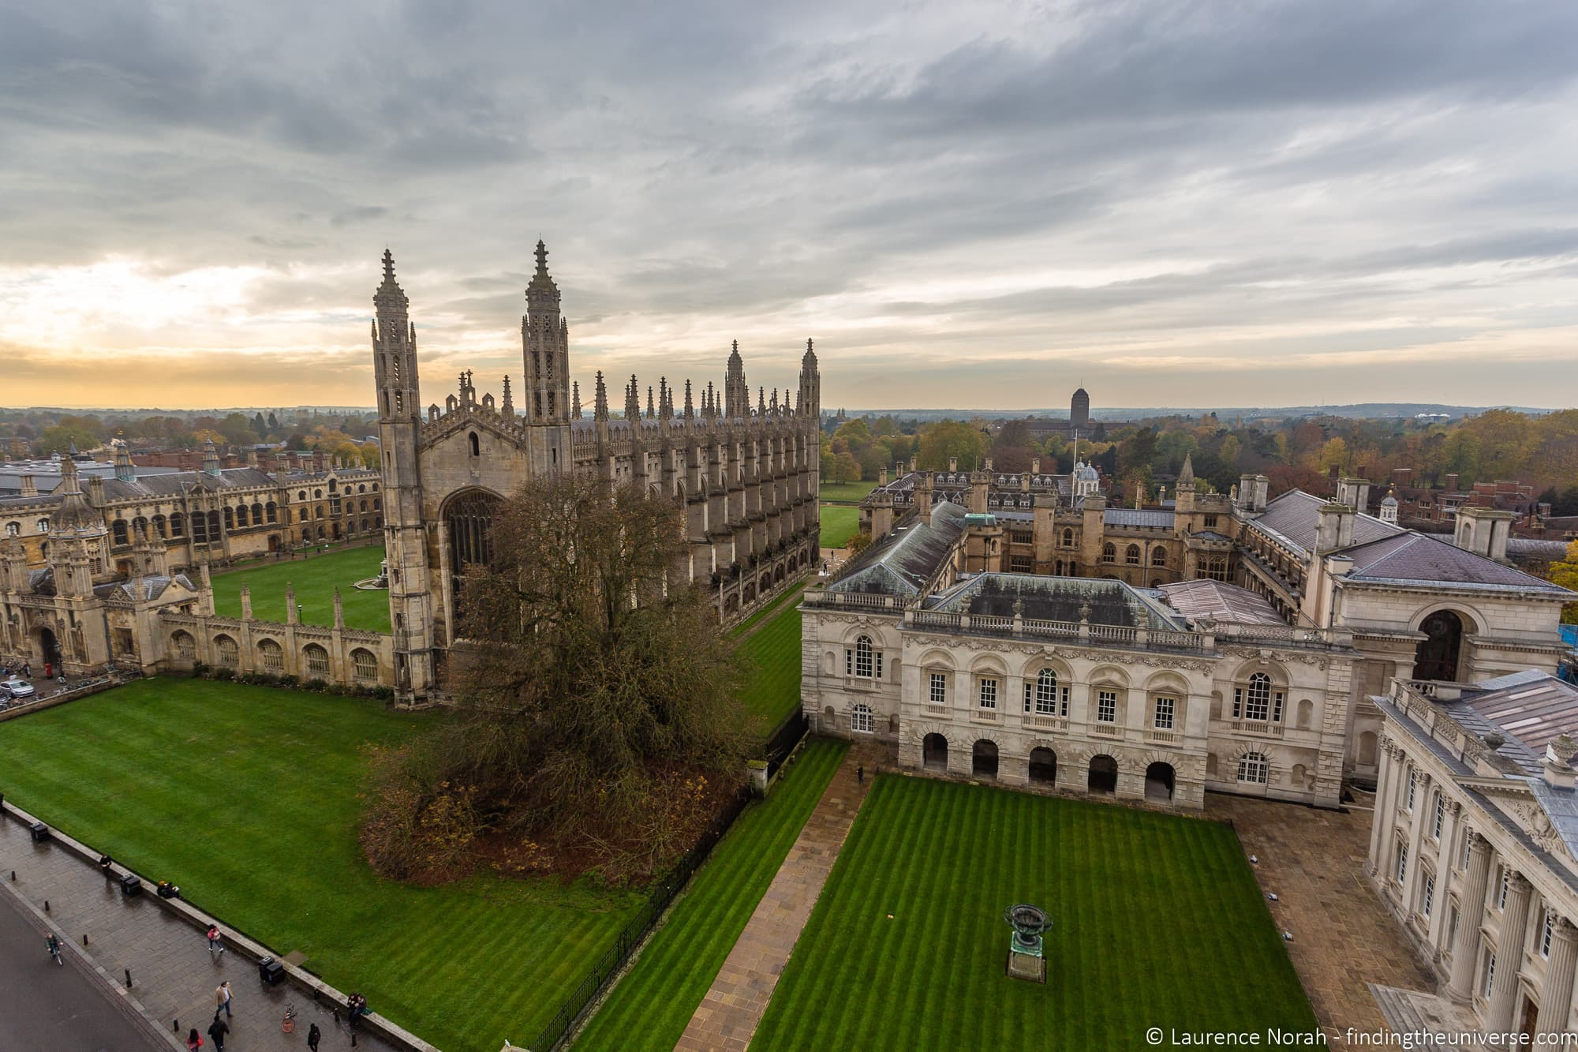

Welcome to Cambridge

Slide 2
9.30am
Presentations from key support services
10.30am
Small group networking:
Supporting your research & role
Employee benefits & services
Opportunities in teaching, communications & policy
Communities & networks
Developing business and entrepreneurial skills
11.15
Refreshments and fair

Slide 3
Office of Postdoctoral Affairs
OPdA

Slide 4
“Our postdocs, alongside our postgraduate students, embody our future and our world-class scholarly ambition, and they deserve the ambition on our part to match it.
They are, and will be, successful but we must also want them to think of Cambridge as the place that changed their lives, and helped and supported them in all aspects at this critical time in their careers.
In achieving that, we empower them to ensure the continued international standing of the University.”
Prof. Sir Leszek Borysiewicz
Vice-Chancellor 2010-2017

Slide 5
What’s special about Cambridge?
Self-governing: At times bureaucratic – but highly democratic
Collegiate: 31 interdependent, self-governing Colleges
Size: 19K students, 11k staff, of which 4000+ postdocs
International: Over 50% of postdocs (90 nationalities) and 28% academic staff
Notes:
Everyone knows we are highly ranked, with excellent research, productive partnerships with industry etc, but what makes us different?

Slide 6
Cambridge’s people
Students
Staff
Total – 19,000
Undergraduates – 12,000
Postgraduates – 7,000
Total – 11,000
Academic (inc clinical) – 1,700
Academic-related – 1,700
Postdoc researchers – 4,000
Assistant – 3,600

Slide 7


How Cambridge is structured
Colleges
University
Faculties &
Departments
Non-School
Institutions
Academic
Services
University
Businesses
Staff & Student
Services
Central
Admin

Slide 8
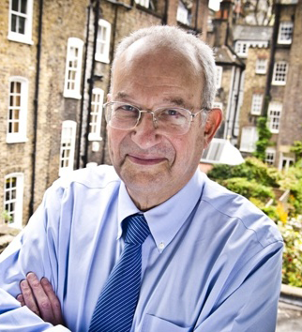
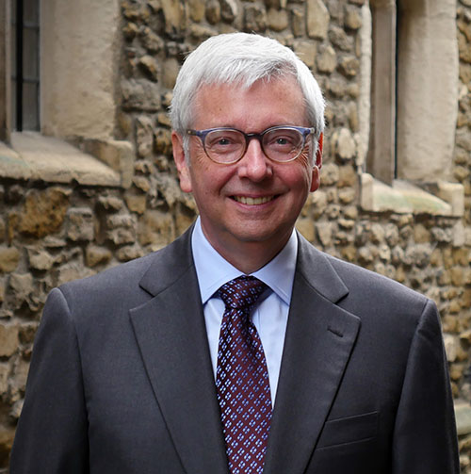
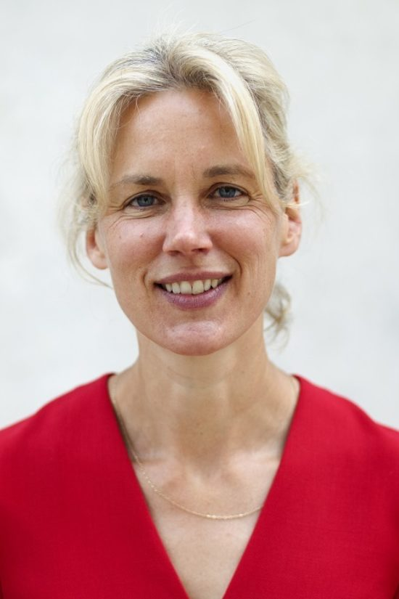
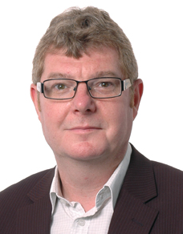
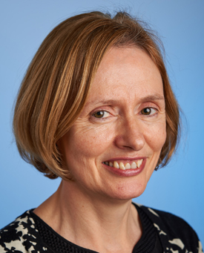
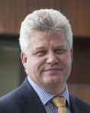
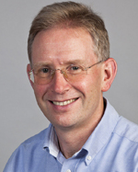
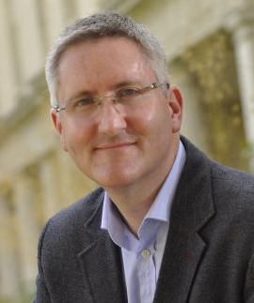
Senior members of the University
Chancellor
Lord Sainsbury of Turville
Vice-Chancellor
Professor Stephen Toope
Registrary
Emma Rampton
The Pro-Vice-Chancellors
Professor David Cardwell
Strategy and Planning
Professor Eilis Ferran
Institutional & International Affairs
Professor Andy Neely
Enterprise & Business Relations
Professor Chris Abell
Research
Professor Graham Virgo
Education

Slide 9
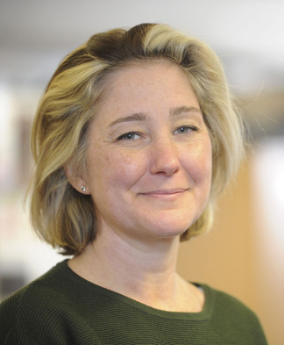
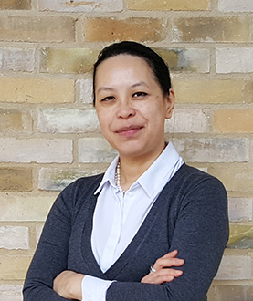
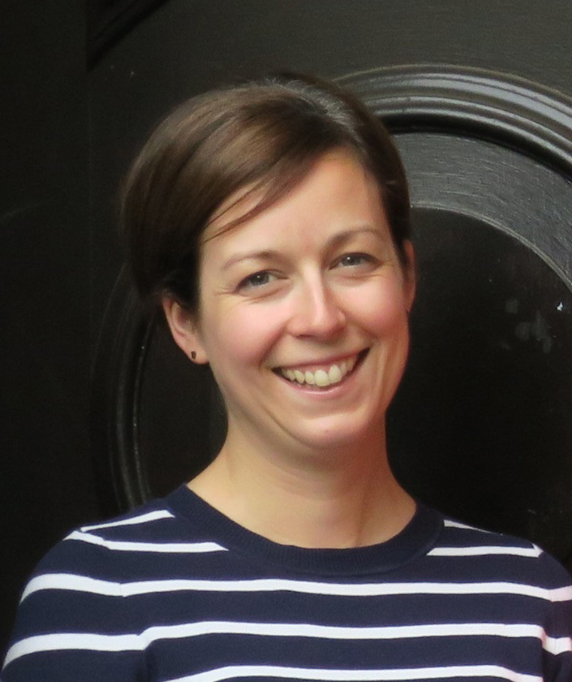
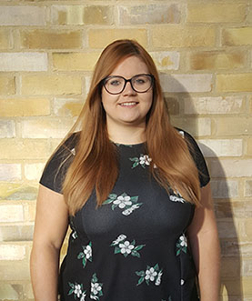
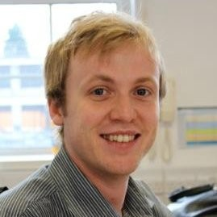
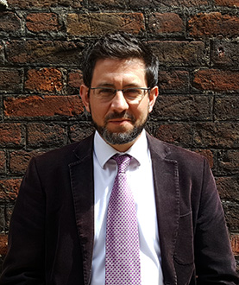
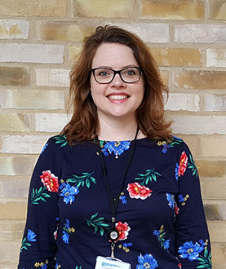
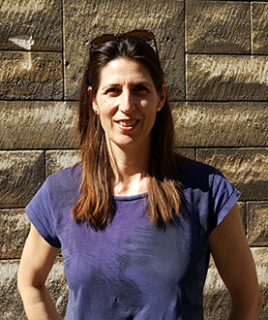
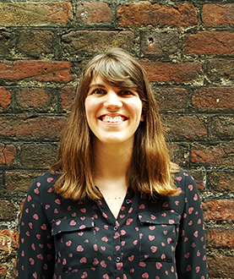
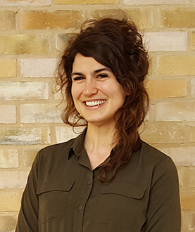
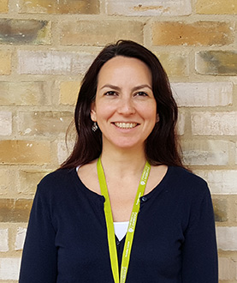
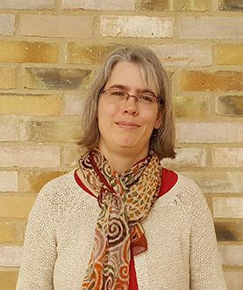
Meet the OPdA team
Josh
James
Karina
Susie
Liz
Hollie
Josh
Nicole
Katia
Jenny
Kristen
Ceren
Anke

Slide 10
Why are we here?
Enable Postdocs to
Realise Their Potential
Professional
Development
Entrepreneurship
Leadership
Fellows
Policy
Pastoral
Services

Slide 11
Here to help on your Postdoc Journey
Pre-Arrival | Recruitment, visa and work permits
Arrival | Location information, accommodation, settling in, family support
Settling in to work | Induction, probation, individual development plan, careers and training introduction
During your post | Review, mentoring, personal and professional development, advancement, entrepreneurship, career planning
Engagement | Representation, College life, social activities, family life
End of contract & next step | Fellowships, renewal, alumni benefits, mentoring

Slide 12
What postdocs asked for
1. Research Excellence and Recognition | 2. Strategic Career Plan & Progression | 3. Leadership Opportunities | 5. Representation at Dept. & University
 |  | 4. Teaching Opportunities
6. Appropriate & Timely Mentoring | 7. Meaningful Professional Review | 8. Personal and Professional Development | 9. Moving to Careers Outside Academia
10. Networking (Professionally & Socially) | 11. Timely Induction & Welcome in Cambridge | 12. Alumni Benefits on leaving Cambridge | 13. College Affiliations
14. Wellbeing and Family Support
Notes:
Ask Karina about colour coding on this slide.

Slide 13

Mentoring for postdocs – 2020 scheme now open
Postdocs are individually matched with an academic working in a related but different research area or with a mentor from outside academia
Postdocs can be mentored on a range of topics, including:
  career development and progression
  work-life balance / parenthood
  management / colleague / team issues
  self reflection / growth / confidence building
  goal setting
As part of the programme, mentors and postdocs:
  will receive training on developmental mentoring to facilitate interactions
  will meet 4-6 times over a 1-year period
Notes:
When’s the next open call – people want to know this.

Slide 14
College affiliations
A formal College attachment allows postdocs to carry on with their day-to-day research whilst enjoying the facilities, benefits, teaching opportunities and interdisciplinary contacts that a College could offer.
In 2015 the OPdA launched a project to expand College affiliations across the University.
Affiliation opportunities have expanded 33% since 2016 with more than 25% of the overall postdoc community now holding affiliations
Approximately 900 postdocs are currently affiliated, with around 700 being non-stipendiary and typically tenured for one to three years
Currently 22 Colleges receive funding to run facilitated activities and benefit from a network of college postdoc convenors

Slide 15
Keeping you informed
The OPdA provides a clear point of information and regular updates through:
Weekly email bulletin with upcoming events, training, funding and other opportunities
Follow us on Twitter for news & updates from/for the postdoc community
Online Postdoc Calendar:
collates events for postdocs from over 20 providers across the University
www.opda.cam.ac.uk

Slide 16
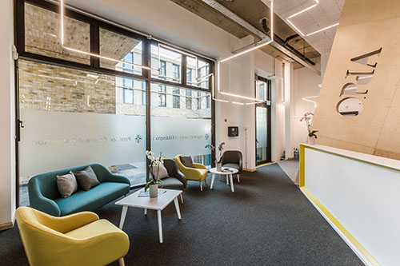
The Postdoc Centres
Mill Lane, 2014
Eddington, 2017
Biomedical Campus, 2016

Slide 17
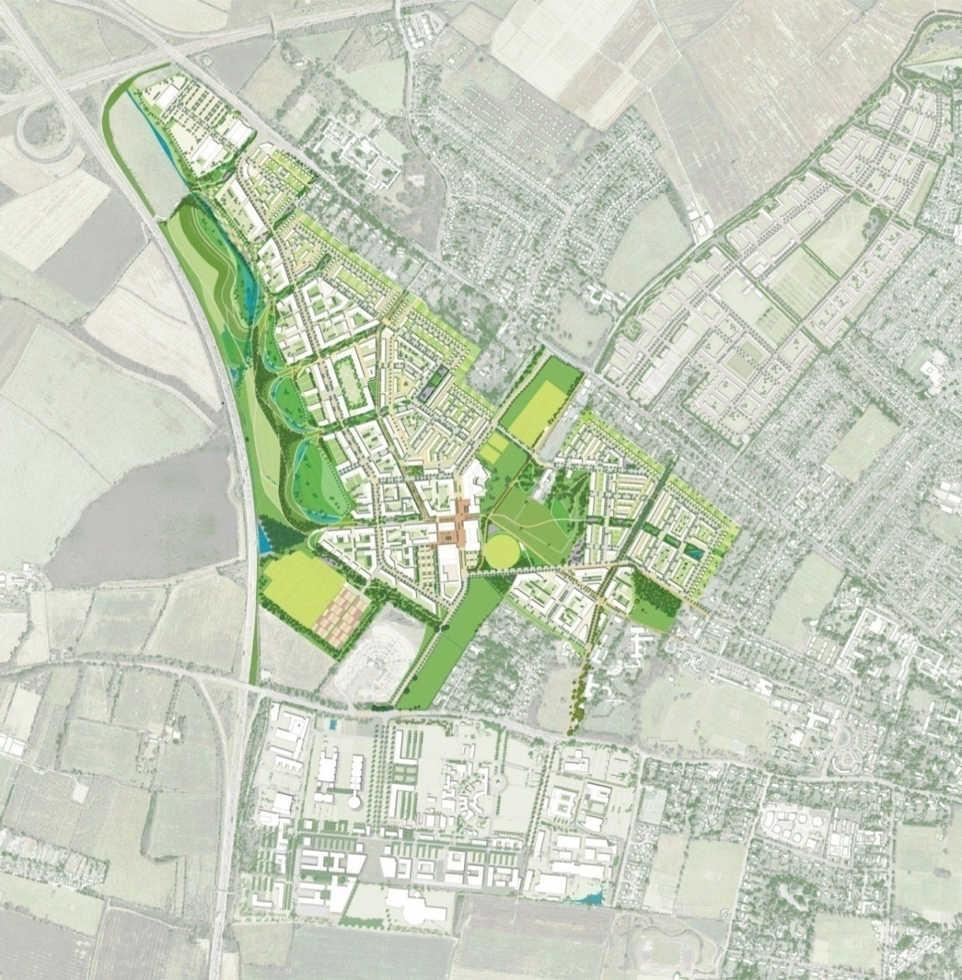
Planning for the future – North West Cambridge
Phase 1 in 2017
700+ units for key worker housing
Phase 2 another 750 units
Supermarket, shops, café, health centre, primary school, nursery, community centre
Sustainable buildings and landscape by outstanding architects
Priority for walking, cycling and bus access to city centre

Slide 18

The Concordat to support researchers
National agreement on supporting and managing researchers
Building a positive and healthy research culture – lots of good expected to come from this.
Brings you many benefits, but also responsibilities…
Funders already committed, Cambridge expects to commit by Christmas.

Slide 19
The Concordat & 14 needs
Environment & culture
5. Postdocs are represented at departmental & university level | 4. Postdocs have access to teaching development opportunities | 10. Postdocs have networking opportunities, both professionally and socially | 8. Postdocs have access to personal and professional development opportunities, including a centrally managed listing for all training opportunities
12. Postdocs receive alumni benefits on leaving Cambridge | 3. Postdocs have access to leadership development opportunities | 13. Postdocs have access to Collegiate Cambridge, i.e. College affiliation
14. Postdocs have access to services and activities to enhance their wellbeing as well as identifying sources of family support | 1. Postdocs have the opportunity and resources to achieve research excellence and recognition for contributions to their research community | 9. Postdocs are supported when moving to careers outside academia
11. Postdocs have a timely induction and are welcomed to Cambridge, both at a university and departmental level | 2. Postdocs have support for their strategic career plan and progression, transition to becoming an independent researcher, progression within Cambridge | 6. Postdocs have access to appropriate and timely mentoring support, including postdocs on short term contracts
7. Postdocs have a meaningful, timely and regular professional review with a PI or line manager
Professional & career development
Employment
Notes:
Something revolutionary, engage the community and ask what they need
Review process – internal and external - concordat

Slide 20
Contact Us
contact.opda@admin.cam.ac.uk
www.opda.cam.ac.uk
www.twitter.com/@opdacam
01223 336 661

