Slide 1
The Business Face of the Cambridge Research Community

Slide 2
Mission
To promote entrepreneurial mindset in Cambridge postdocs

Slide 3
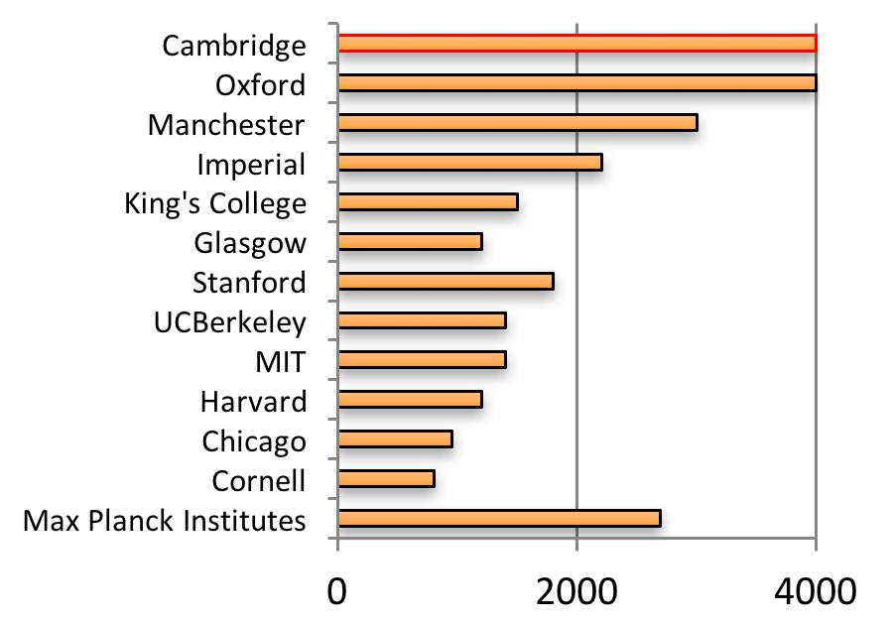
Why ?
~ 4000 postdocs
Unique asset to the Cambridge ecosystem
Subject Experts
Making postdocs innovative and entrepreneurial will be hugely beneficial

Slide 4
Monthly networking events
University Spinouts
Financial Support
Accelerator
How to write a Business Plan
Business Model Canvas
Companies
Workshops

Slide 5
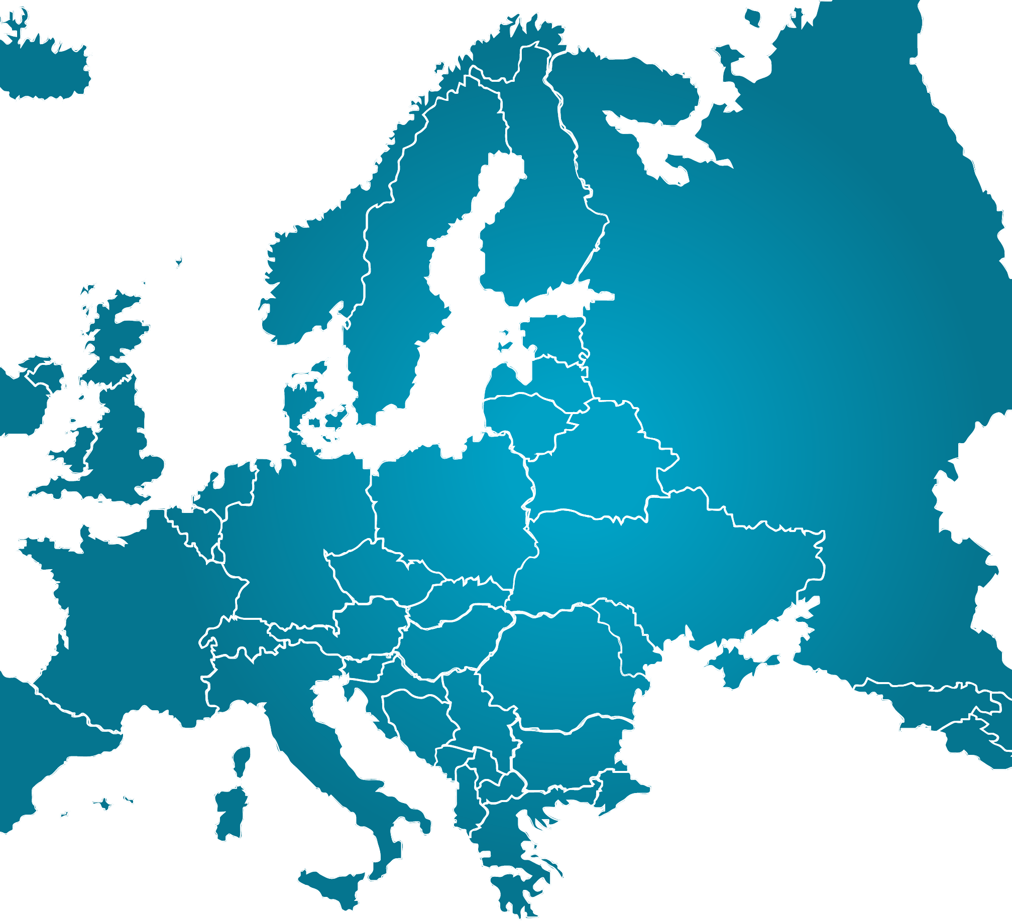
Postdocs to Innovators (p2i) Network
Developing European-wide training for researchers
Establishing EPOC-like organisations
Academic partners
Enterprise partners

Slide 6
Training & Courses
Postdoc-specific Entrepreneurship course
Developed through p2i collaboration
Impulse at Maxwell Centre
Accelerate Cambridge, Venture Creation Weekend, Ignite
Postdoc Consultancy Scheme
Short-term projects

Slide 7
Milner Innovation Representative
Early-career scientists (postdocs)
Facilitate interactions between academics and companies (biotech and pharma)
Notes:
Cambridge is very fragmented – the dept title doesn’t give away the nature of research it conducts. So we have spokes representatives from different departments.

Slide 8
Postdoc Business Plan Competition
Previous finalists:
Poro Technologies Ltd
Deadline: 14 July
NeutroCheck

Slide 9
EPOC committee

Slide 10
Sponsors
Event sponsors:

Slide 11
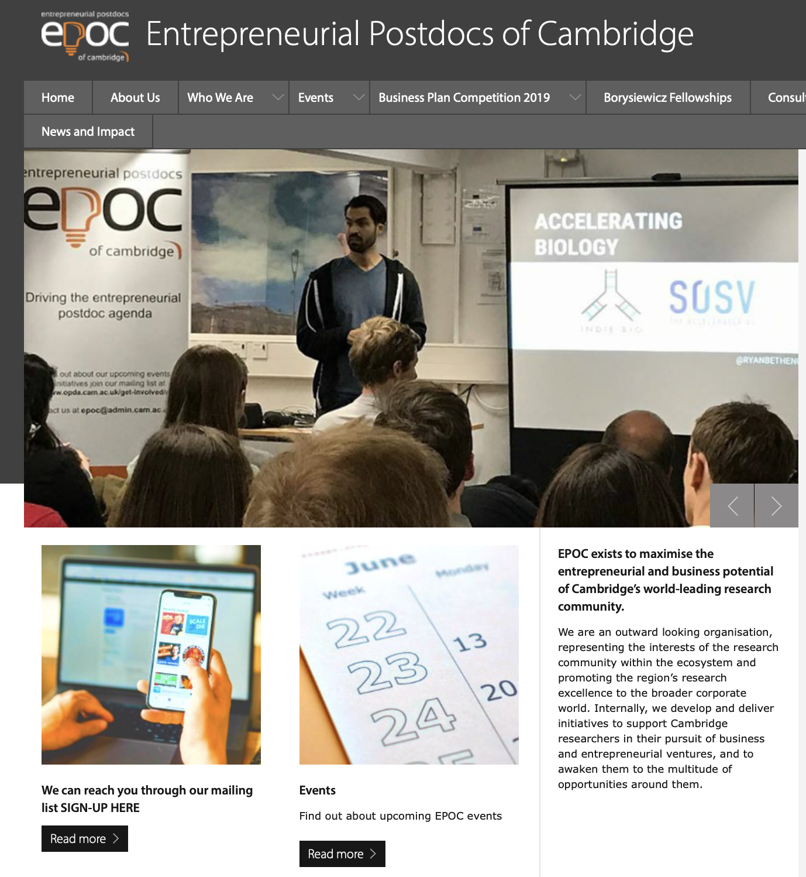
Get involved
epoc@admin.cam.ac.uk

