Slide 1
WE’RE HERE TO HELP
YOUR CAREER

Slide 2
What do postdocs say about us?
https://vimeo.com/296867868/5686d3a351
Notes:
https://vimeo.com/296867868/5686d3a351

Slide 3
We helped almost 2000 postdocs improve their career prospects last year!
Over a decade of expertise… knowledge about careers in and outside of academia… working with colleagues across the University to help you make the most of your time…

Slide 4
The reassurance slide!
We know what it’s like to be you.
Our support is tailored to you.
It’s confidential and impartial.
It’s free and unlimited.
I wouldn’t be where I am today without you guys!
Krishnaa, Postdoc at the Department of Surgery

Slide 5
C
Career options?
CVs?
Interviews?
Fellowships?

Slide 6
What kind of help suits you?
Do you want to focus on your individual needs? Come and see us for an appointment.
Do you enjoy learning through experience and with others? Try one of our interactive workshops.
Do you like to hear from the experts? Attend one of our panel events.
Do you prefer to read about it? Download our CV book or pick up one of our Quick Guides.

Slide 7
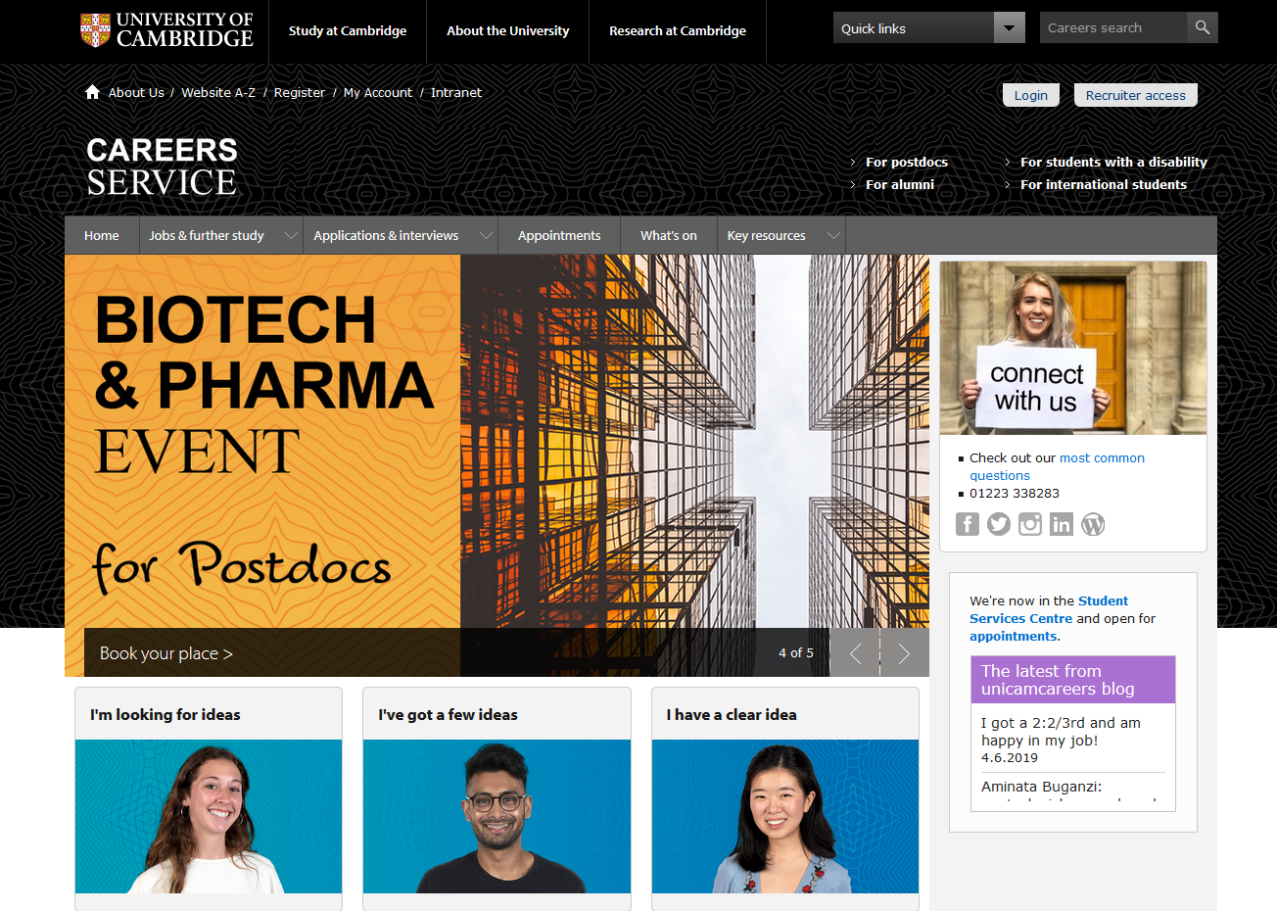
Register with us today
www.careers.cam.ac.uk

Slide 8
Follow @unicamcareers on Twitter
Our mission is that no postdoc should leave this University wishing they’d known about the Postdoc Careers Service sooner.
Help us spread the word.

