Slide 1


Office of Postdoctoral Affairs
OPdA

Slide 2
“Our postdocs, alongside our postgraduate students, embody our future and our world-class scholarly ambition, and they deserve the ambition on our part to match it.
They are, and will be, successful but we must also want them to think of Cambridge as the place that changed their lives, and helped and supported them in all aspects at this critical time in their careers.
In achieving that, we empower them to ensure the continued international standing of the University.”
Prof. Sir Leszek Borysiewicz
Vice-Chancellor 2010-2017

Slide 3
An introduction – the University’s profile
4th in THE World University Rankings 2018/2019
1st in The Complete University Guide, UK 2017/18 and 2019
More Nobel Prize Winners than any other institution – 107 since 1904
87% of permanent academic staff deemed ‘world-leading’ or ‘internationally excellent’
Excellence across the sciences and humanities
Partnerships with many industries, enterprises, other universities
Total income over £900M (excludes CUP, Cambridge Assessment, Trusts)
Stepping stone for many towards an academic career
Place where industry and public service look for the best

Slide 4
The composition
31 interdependent Colleges, self-governing within the University
150+ faculties and departments within six Schools
Arts and Humanities, Biological Sciences, Humanities & Social Sciences, Physical Sciences, Clinical Medicine, Technology
Non-School institutions
University Library, Fitzwilliam Museum, Botanic Garden
University businesses
Cambridge University Press, Cambridge Assessment, Cambridge Enterprise
Unified Administrative Service – managed by the Registrary

Slide 5
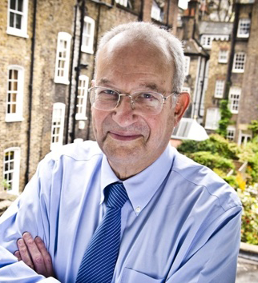
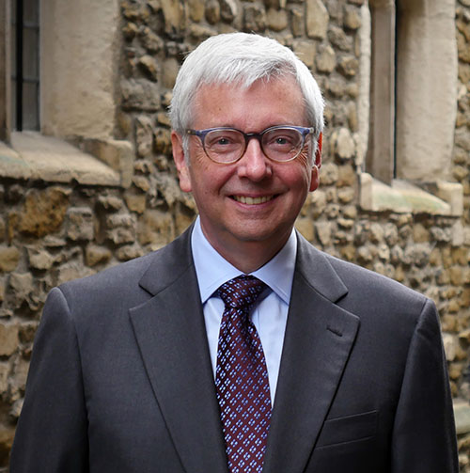
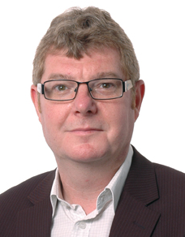
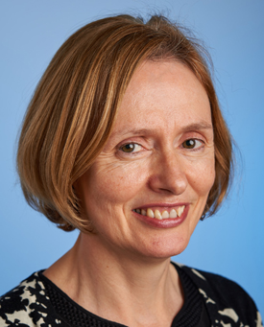
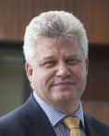
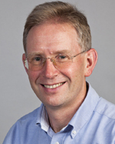
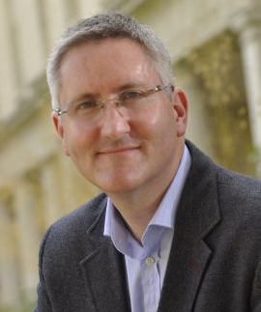
Senior members of the University
Chancellor
Lord Sainsbury of Turville
Vice-Chancellor
Professor Stephen Toope
The Pro-Vice-Chancellors
Professor David Cardwell
Strategy and Planning
Professor Eilis Ferran
Institutional & International Affairs
Professor Andy Neely
Enterprise & Business Relations
Professor Chris Abell
Research
Professor Graham Virgo
Education

Slide 6
Complex structure, simple principles
Evolved over 800 years
Self-governing
At times bureaucratic – but highly democratic

Slide 7
A national and an international university
A British university
An international university
72% academic staff
89% undergraduates
28% academic staff
37% ‘overseas’ postgraduates
over 50% postdocs

Slide 8
Cambridge’s people
Students
Staff
Total – 19,000
Undergraduates – 12,000
Postgraduates – 7,000
Total – 11,000
Academic (inc clinical) – 1,700
Academic-related – 1,700
Postdoc researchers – 4,000
Assistant – 3,600

Slide 9
Postdocs at Cambridge
Key Numbers
University Postdocs by School
~3,500 in University and Colleges
~500 in Partner Institutes
35% of total University staff
90 nationalities

Slide 10
The Postdoc Journey
Pre-Arrival | Recruitment, visa and work permits
Arrival | Location information, accommodation, settling in, family support
Settling in to work | Induction, probation, individual development plan, careers and training introduction
During your post | Review, mentoring, personal and professional development, advancement, entrepreneurship, career planning
Engagement | Representation, College life, social activities, family life
End of contract & next step | Fellowships, renewal, alumni benefits, mentoring

Slide 11


The Concordat
Revised Concordat due August 2019 – public Launch September 2019
Set of agreed principals to support the Career Development of Researchers
Recruitment and retention
Essential part of human resources and research strategies
Adaptable and flexible in global research environment
Personal and career development and lifelong learning
Shared responsibility for careers
Diversity and equality
Regular and collective progress review
HR Excellence in Research Award

Slide 12
What postdocs asked for
1. Research Excellence and Recognition | 2. Strategic Career Plan & Progression | 3. Leadership Opportunities | 5. Representation at Dept. & University
 |  | 4. Teaching Opportunities
6. Appropriate & Timely Mentoring | 7. Meaningful Professional Review | 8. Personal and Professional Development | 9. Moving to Careers Outside Academia
10. Networking (Professionally & Socially) | 11. Timely Induction & Welcome in Cambridge | 12. Alumni Benefits on leaving Cambridge | 13. College Affiliations
14. Wellbeing and Family Support

Slide 13
OPdA Mission
Enable Postdocs to
Realise Their Potential
Professional
Development
Entrepreneurship
Leadership
Fellows
Policy
Pastoral
Services

Slide 14
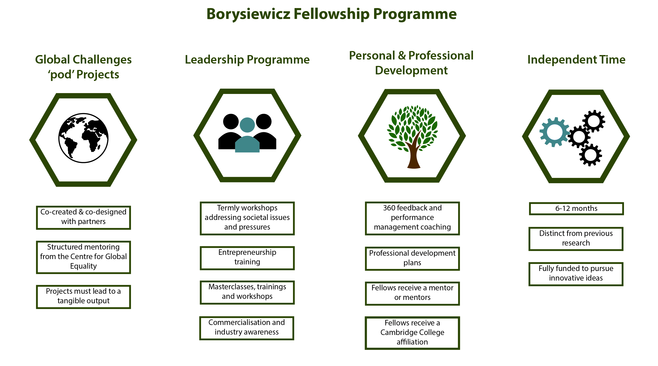
Leadership Fellowships

Slide 15
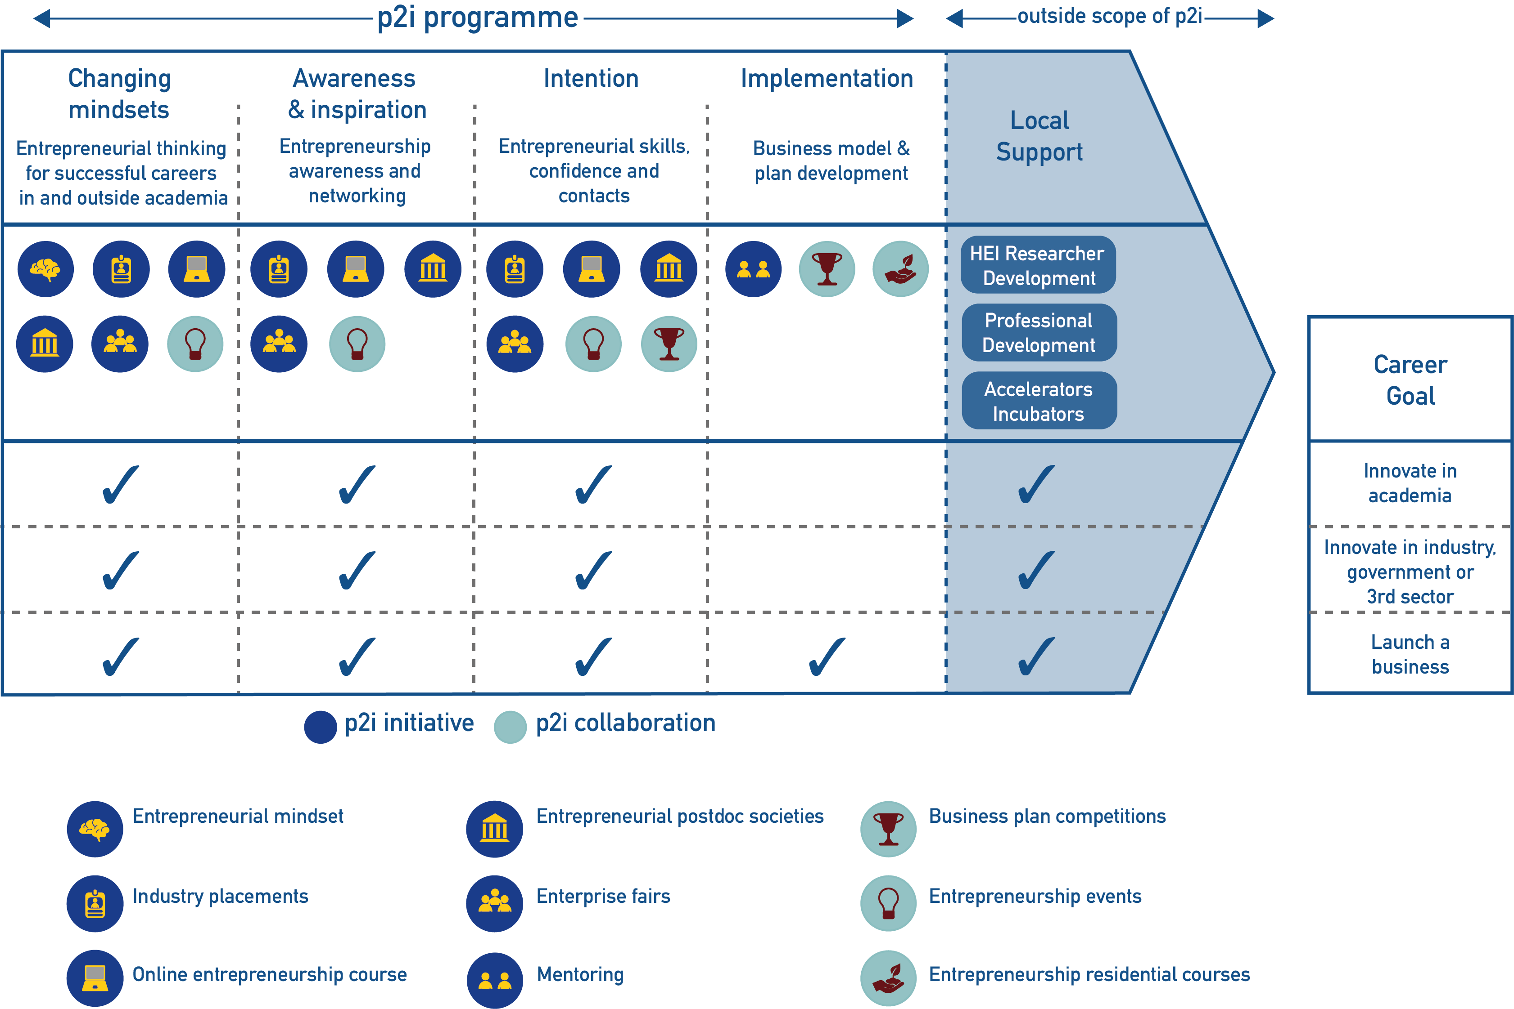
Postdocs to Innovators
Developing researchers to pursue careers that will be personally and professionally meaningful both within and outside of academia

Slide 16

Mentoring for postdocs
Postdocs are individually matched with an academic working in a related but different research area or with a mentor from outside academia
Postdocs can be mentored on a range of topics, including:
  career development and progression
  work-life balance / parenthood
  management / colleague / team issues
  self reflection / growth / confidence building
  goal setting
As part of the programme, mentors and postdocs:
  will receive training on developmental mentoring to facilitate interactions
  will meet 4-6 times over a 1-year period

Slide 17
College affiliations
A formal College attachment allows postdocs to carry on with their day-to-day research whilst enjoying the facilities, benefits, teaching opportunities and interdisciplinary contacts that a College could offer.
In 2015 the OPdA launched a project to expand College affiliations across the University.
Affiliation opportunities have expanded 33% since 2016 with more than 25% of the overall postdoc community now holding affiliations
Approximately 900 postdocs are currently affiliated, with around 700 being non-stipendiary and typically tenured for one to three years
Currently 22 Colleges receive funding to run facilitated activities and benefit from a network of college postdoc convenors

Slide 18
Keeping you informed
The OPdA provides a clear point of information and regular updates through:
Weekly email bulletin with upcoming events, training, funding and other opportunities
Follow us on Twitter for news & updates from/for the postdoc community
Online Postdoc Calendar:
collates events for postdocs from over 20 providers across the University
www.opda.cam.ac.uk

Slide 19
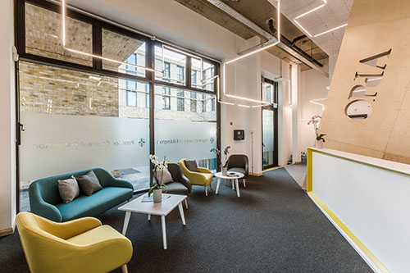
The Postdoc Centres
Mill Lane, 2014
Eddington, 2017
Biomedical Campus, 2016

Slide 20
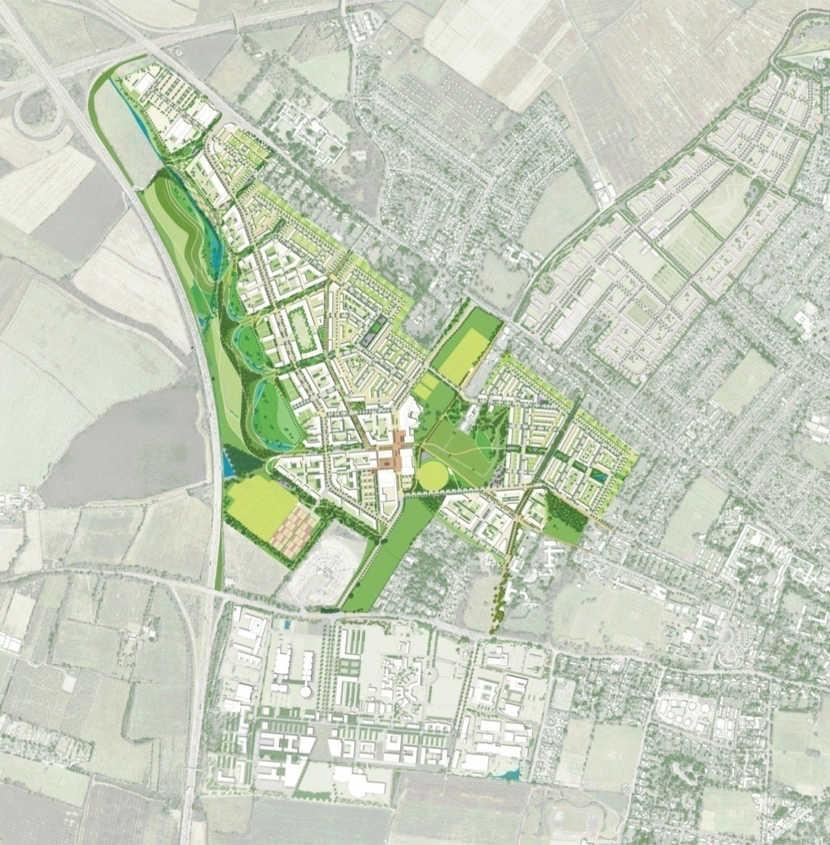
Planning for the future – North West Cambridge
Phase 1 in 2017
700+ units for key worker housing
Phase 2 another 750 units
Supermarket, shops, café, health centre, primary school, nursery, community centre
Sustainable buildings and landscape by outstanding architects
Priority for walking, cycling and bus access to city centre

Slide 21



Organisations that can help and support you

Slide 22
Contact Us
contact.opda@admin.cam.ac.uk
www.opda.cam.ac.uk
www.twitter.com/@opdacam
01223 336 661

