Slide 1

University of Cambridge
Postdoc Academy

Slide 2
“Our postdocs, alongside our postgraduate students, embody our future and our world-class scholarly ambition, and they deserve the ambition on our part to match it.
They are, and will be, successful but we must also want them to think of Cambridge as the place that changed their lives and helped and supported them in all aspects at this critical time in their careers.
In achieving that, we empower them to ensure the continued international standing of the University.”
Prof. Sir Leszek Borysiewicz
Vice-Chancellor 2010-2017

Slide 3
What’s special about Cambridge?
Self-governing: At times bureaucratic – but highly democratic
Collegiate: 31 interdependent, self-governing Colleges
Size: 19k students (12k undergrad, 7k postgrad)
11k staff (1.7k academic, 1.7k academic-related, 3.6k assistant + 4k postdocs
International: Over 50% of postdocs (90 nationalities) and 28% academic staff

Slide 4
The composition
31 interdependent Colleges, self-governing within the University
150+ faculties and departments within six Schools
Arts and Humanities, Biological Sciences, Humanities & Social Sciences, Physical Sciences, Clinical Medicine, Technology
Non-School institutions
University Library, Fitzwilliam Museum, Botanic Garden
University businesses
Cambridge University Press, Cambridge Assessment, Cambridge Enterprise
Unified Administrative Service – managed by the Registrary

Slide 5
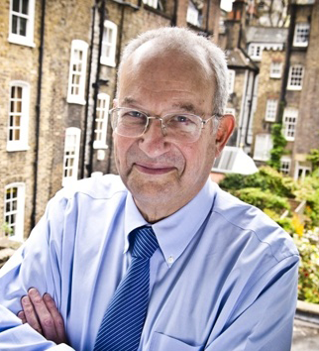
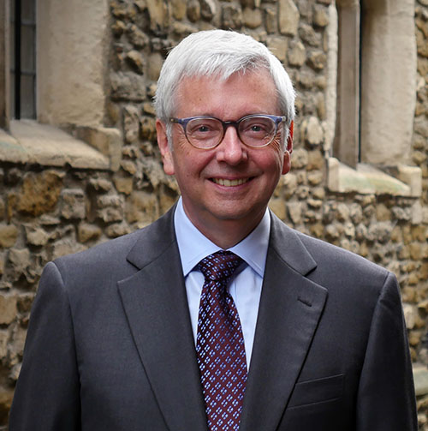
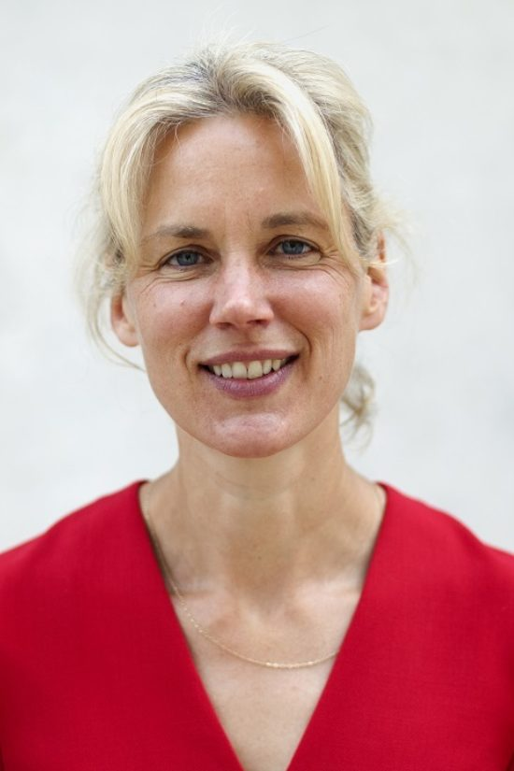
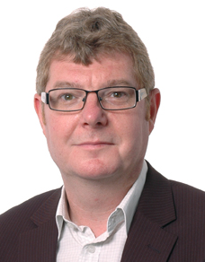
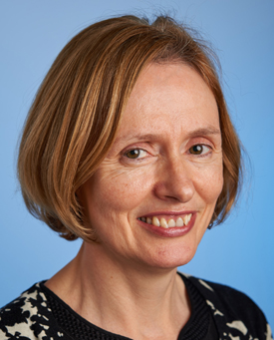
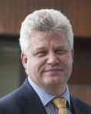
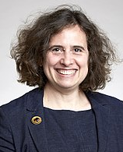
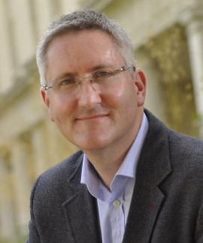

Senior members of the University
Chancellor
Lord Sainsbury of Turville
Vice-Chancellor
Professor Stephen Toope
Registrary
Emma Rampton
The Pro-Vice-Chancellors
Professor David Cardwell
Strategy and Planning
Professor Eilis Ferran
Institutional & International Affairs
Professor Andy Neely
Enterprise & Business Relations
Professor Anne Ferguson-Smith
Acting Pro-Vice Chancellor for Research
Professor Graham Virgo
Education

Slide 6
Why are we here?
Enable Postdocs to Realise Their Potential
A home for postdocs
Welcome, communities & spaces
A voice for postdocs
Policy and advocacy
A positive and thriving research culture
Enhancing the postdoc experience
RD, entrepreneurship, leadership and fellowships
Linking to the world
beyond Cambridge
Corporate engagement and alumni

Slide 7
Research culture
What is it?
The norms in behaviours, expectations, attitudes and values of our research communities.
National drive to change research culture, driven by Royal Society and Wellcome Trust and now all funders, and the Concordat.
Cambridge has ambitions to create a more positive culture for all our researchers.
Developing action plan – input invited from postdoc community this summer.

Slide 8
Keeping you informed
The OPdA provides a clear point of information and regular updates through:
Weekly email bulletin with upcoming events, training, funding and other opportunities
Follow us on Twitter for news & updates from/for the postdoc community
Online Postdoc Calendar:
collates events for postdocs from over 20 providers across the University
www.postdocacademy.cam.ac.uk

Slide 9
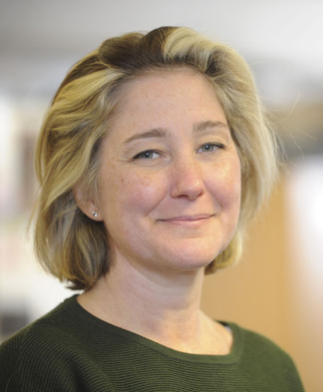
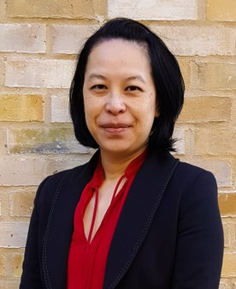
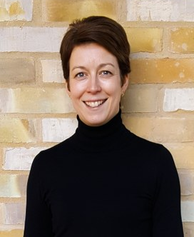
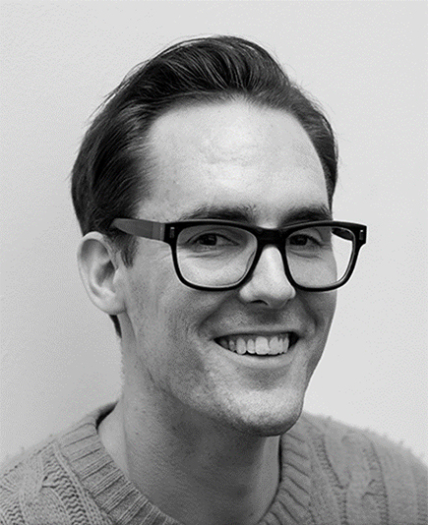
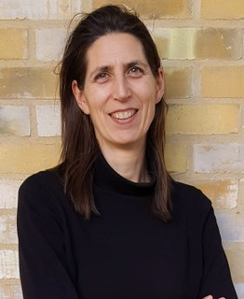
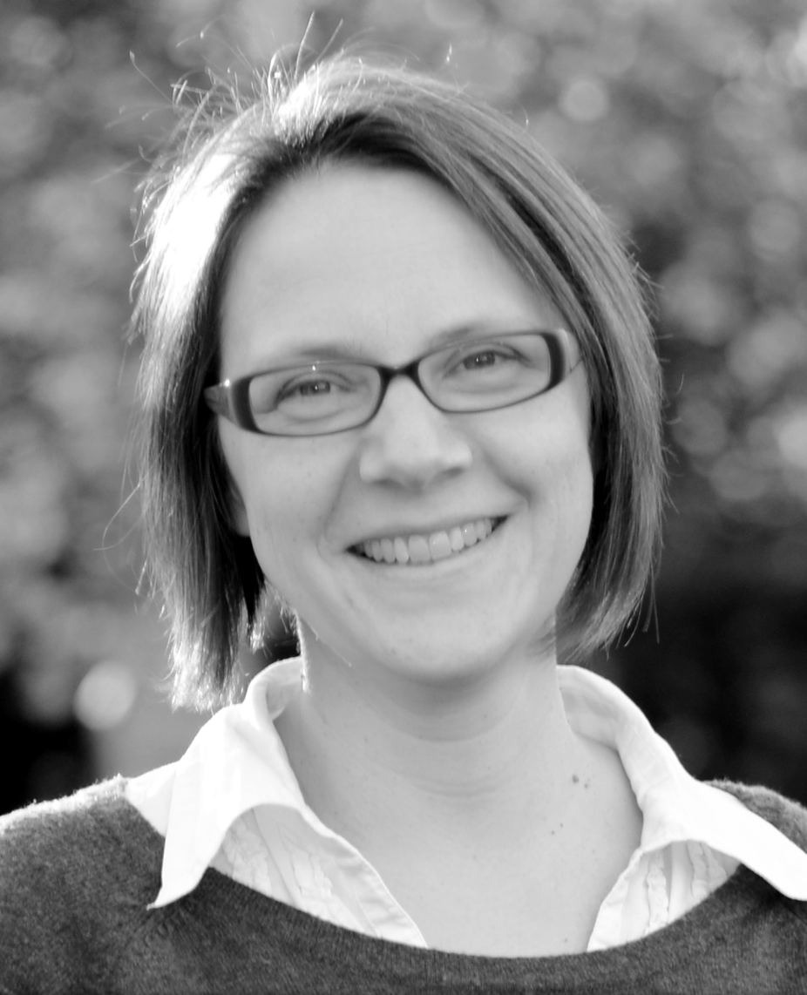
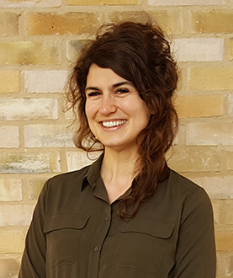
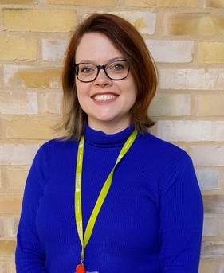
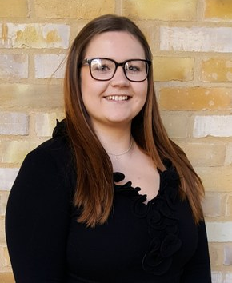
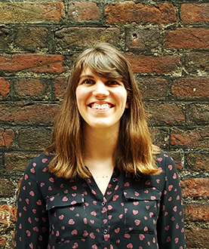
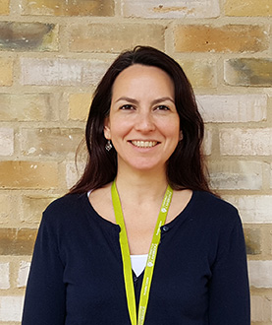
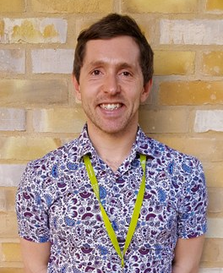
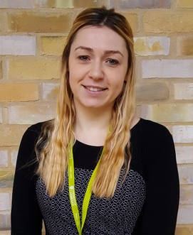
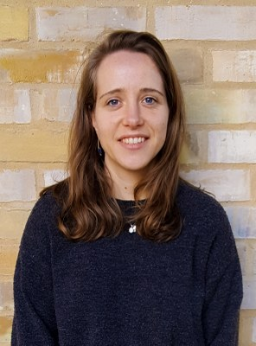
Contact us
contact.pda@admin.cam.ac.uk
www.postdocacademy.cam.ac.uk
www.twitter.com/@Postdoc_Academy
01223 336661
Karina
Susie
Liz
Steve
Katia
Hannah
Kristen
Nicole
Hollie
Jenny
Ceren
Shaun
Stephanie
Lydia

